Slide 1
Collections framework --java.util “Without using collection concepts, you cannot develop any production level software application in Java” “Java collections framework is the most important concept for developing the project and crack interviews”

Slide 2
Collections Framework -A collection is a group of objects. -A collection in java is a container object that is used for storing multiple homogeneous and heterogeneous, duplicate, and unique elements without any size limitation. -A framework in java is a set of several classes and interfaces which provide a ready-made architecture. - A collections framework is a class library to handle groups of objects. -It allows to store, retrieve, and update a group of objects.

Slide 3
-Collections framework in Java supports two types of containers: =>collection :For storing a collection of elements (objects). => map :For storing key/value pairs. -Java collections framework provides an API to work with data structures such as lists, trees, sets, and maps. -It offers a set of reusable data structures, algorithms, and utilities for managing collections of objects in Java programming. -It saves developers time and effort by providing efficient implementations of common data structures.

Slide 4
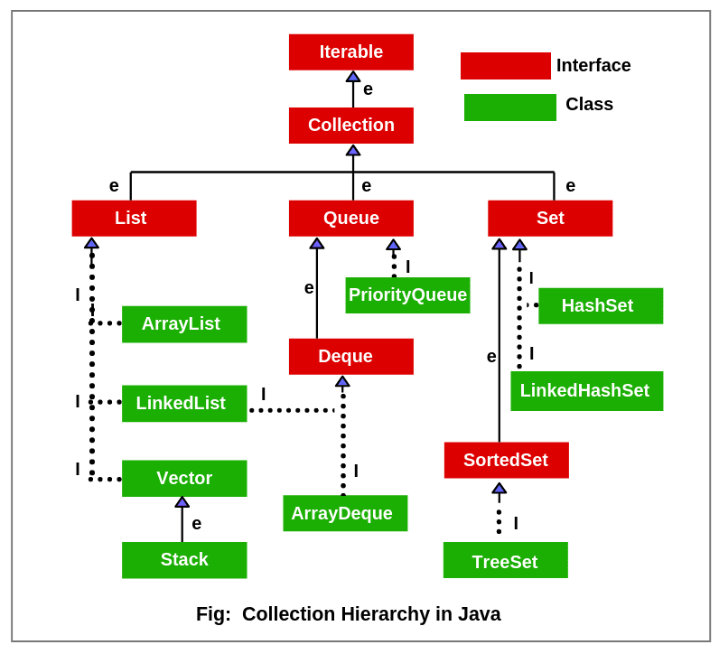

Slide 5
Key Interfaces in Collections Framework -Java programming language built the collections framework around four core interfaces: -Collection -List -Set -Map

Slide 6
-The basic interface of the collections framework is the Collection interface which is the root interface of all collections in the API . -It is placed at the top of the collection hierarchy in java. It provides the basic operations for adding and removing elements in the collection. -Collection interface extends the Iterable interface. The iterable interface has only one method called iterator(). The function of the iterator method is to return the iterator object. Using this iterator object, we can iterate over the elements of the collection. -List, Queue, and Set have three components which extends the Collection interface. A map is not inherited by Collection interface.

Slide 7
List of Interfaces defined in java.util package Collection List Queue Comparator ListIterator RandomAccess Deque Map Set Enumeration Map.Entry SortedMap EventListener NavigableMap SortedSet Formattable NavigableSet Iterator Observer

Slide 8
List of classes defined in java.util package AbstractCollection EventObject Random AbstractList FormattableFlags ResourceBundle AbstractMap Formatter Scanner AbstractQueue AbstractSequentialList HashMap AbstractSet HashSet Stack ArrayDeque Hashtable StringTokenizer ArrayList LinkedList Vector Collections EnumMap EnumSet Calender LinkedHashMap TreeMap

Slide 9
Collections Interface Methods add(): Add objects to collection. isEmpty(): Returns true if collection is empty clear(): Removes all elements from the collection remove(): Remove a selected object size(): Find the number of elements stream(): Return Sequential elements toArray(): Returns elements in array format hashCode():Returns Hashcode of the elements

Slide 10
Collections Interface Methods equals(obj X): Compare an element with the collection iterator(): Return an iterator over collection max(): Return max value in the collection contains(): Returns true is a particular value is present spliterator(): Creates splietarator over the elements in the collection retainAll(): Retains elements in the collection

Slide 11
List Interface 1. This interface represents a collection of elements whose elements are arranged sequentially ordered. 2. List maintains an order of elements means the order is retained in which we add elements, and the same sequence we will get while retrieving elements. 3. We can insert elements into the list at any location. The list allows storing duplicate elements in Java. 4. ArrayList, vector, and LinkedList are three concrete subclasses that implement the list interface.

Slide 12
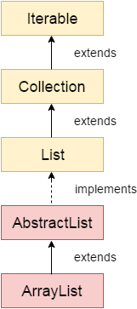
Java ArrayList class
Java ArrayList class uses a dynamic array for storing the elements. It inherits AbstractList class and implements List interface.
The important points about Java ArrayList class are:
Java ArrayList class can contain duplicate elements.
Java ArrayList class maintains insertion order.
Java ArrayList class is non synchronized.
Java ArrayList allows random access because array works at the index basis.
In Java ArrayList class, manipulation is slow because a lot of shifting needs to occur if any element is removed from the array list.

Slide 13
ARRAYLIST OR LIST DECLARATION IN JAVA
Declaration 1:
List<String> arrayList =new ArrayList<String>();
Declaration 2:
ArrayList<String> arrayList =new ArrayList<String>();

Slide 14
Java Non-generic Vs. Generic Collection
Java new generic collection allows you to have only one type of object in a collection. Now it is type safe so typecasting is not required at runtime.
Creating Array List
ArrayList<String> al=new ArrayList<String>();

Slide 15
Java ArrayList Example
public static void main(String args[]){
ArrayList<String> list=new ArrayList<String>();//Creating arraylist
list.add("Ravi");//Adding object in arraylist
list.add("Vijay");
list.add("Ravi");
list.add("Ajay");
//Invoking arraylist object
System.out.println(list);
}
Output :
[Ravi, Vijay, Ravi, Ajay]

Slide 16
Java ArrayList ArrayList can also be created using the interfaces it is implemented from List<String> list=new ArrayList<String>(); AbstractList<int> list1 = new ArrayList<int>();

Slide 17
Some important methods available in ArrayList class
boolean addAll(Collection C): This method is used to append all the elements from a specific collection to the end of the mentioned list, in such a order that the values are returned by the specified collection’s iterator.
boolean add(Object o): This method is used to append a specificd element to the end of a list.
boolean addAll(int index, Collection C): Used to insert all of the elements starting at the specified position from a specific collection into the mentioned list.
void add(int index, Object element): This method is used to insert a specific element at a specific position index in a list.

Slide 18
Some important methods available in ArrayList class
void clear(): This method is used to remove all the elements from any list.
remove​(int index): Removes the element at the specified position in this list.
remove​(Object o): Removes the first occurrence of the specified element from this list, if it is present.
removeAll​(Collection c): Removes from this list all of its elements that are contained in the specified collection.

Slide 19
Some important methods available in ArrayList class
set(int index, E element): Replaces the element at the specified position in this list with the specified element.
get​(int index): Returns the element at the specified position in this list
size​(): Returns the number of elements in this list.
isEmpty​(): Returns true if this list contains no elements.
listIterator​(): Returns a list iterator over the elements in this list (in proper sequence).
forEach​(Consumer action): Performs the given action for each element of the Iterable until all elements have been processed or the action throws an exception.
contains​(Object o): Returns true if this list contains the specified element.

Slide 20
Array List Methods Example - Add
public static void main(String args[]){
ArrayList<String> al=new ArrayList<String>();
al.add("Ajay");
System.out.println("Initial list of elements: \n"+al);
//Adding elements to the end of the list
al.add("Rahul");
System.out.println("add(E e) method: \n"+al);
//Adding an element at the specific position
al.add(1, "Gaurav");
System.out.println("add(int index, E element) method: \n"+al);
ArrayList<String> al2=new ArrayList<String>();
al2.add("Sonoo");
al2.add("Hanumat") ;
//Adding second list elements to the first list
al.addAll(al2);
System.out.println("addAll(Collection<? extends E> c) method: \n"+al);
ArrayList<String> al3=new ArrayList<String>(al2);
//Adding second list elements to the first list at specific position
al.addAll(1, al3);
System.out.println("addAll(int index, Collection<? extends E> c) method: \n"+al);
}

Slide 21
Output :
Initial list of elements:
[Ajay]
After invoking add(E e) method:
[Ajay, Rahul]
After invoking add(int index, E element) method:
[Ajay, Gaurav, Rahul]
After invoking addAll(Collection<? extends E> c) method:
[Ajay, Gaurav, Rahul, Sonoo, Hanumat]
After invoking addAll(int index, Collection<? extends E> c) method: [Ajay, Sonoo, Hanumat, Gaurav, Rahul, Sonoo, Hanumat]

Slide 22
Java ArrayList example to remove elements
public static void main(String [] args)
{
ArrayList<String> al=new ArrayList<String>();
al.add("Ravi");
al.add("Vijay");
al.add("Ajay");
al.add("Jason");
System.out.println("An initial list of elements: "+al);
//Removing specific element from arraylist
al.remove("Vijay");
System.out.println("After invoking remove(object) method: "+al);
//Removing element on the basis of specific position
al.remove(0);
System.out.println("After invoking remove(index) method: "+al);
//Creating another arraylist
ArrayList<String> al2=new ArrayList<String>();
al2.add("Ravi");
al2.add("Hanumat");
//Adding new elements to arraylist
al.addAll(al2);
System.out.println("Updated list : "+al);
//Removing all the new elements from arraylist
al.removeAll(al2);
System.out.println("After invoking removeAll() method: "+al);
//Removing elements on the basis of specified condition
al.removeIf(str -> str.contains("Ajay"));
//Here, we are using Lambda expression
System.out.println("After invoking removeIf() method: "+al);
//Removing all the elements available in the list
al.clear();
System.out.println("After invoking clear() method: "+al);
}

Slide 23
Output :
An initial list of elements: [Ravi, Vijay, Ajay, Jason]
After invoking remove(object) method: [Ravi, Ajay, Jason]
After invoking remove(index) method: [Ajay, Jason]
Updated list : [Ajay, Jason, Ravi, Hanumat]
After invoking removeAll() method: [Ajay, Jason]
After invoking removeIf() method: [Jason]
After invoking clear() method: []

Slide 24
Java ArrayList example of isEmpty(),retainAll(),get(),set()
public static void main(String args[]){
ArrayList<String> al=new ArrayList<String>();
System.out.println("Is ArrayList Empty: "+al.isEmpty());
al.add("Ravi");
al.add("Vijay");
System.out.println("Is ArrayList Empty: "+al.isEmpty());
System.out.println("Before update: "+al.get(1));
al.set(1,"Gaurav");
System.out.println("After update: "+al.get(1));
System.out.println("After updating the list: "+al);
ArrayList<String> al2=new ArrayList<String>();
al2.add("Ravi");
al2.add("Hanumat");
al.retainAll(al2);
System.out.println("After retainAll() : "+al);
}
Output :
Is ArrayList Empty: true
Is ArrayList Empty: false
Before update: Vijay
After update: Gaurav
After updating the list: [Ravi, Gaurav]
After retainAll() : [Ravi]

Slide 25
Difference between Arrays and ArrayList
Sl.No | Array | ArrayList
1 | Fixed size arrays | Size need not be specified. Even if specify a capacity, we can add elements later
2 | Accessed using index in [] | ArrayList has methods to access it’s elements
3 | Array can contain primitive and non-primitive data types | ArrayList supports only objects
4 | Primitive datatypes are stored in contiguous locations. In case of objects, allocation is similar to ArrayList | Members are always references to objects at different memory locations. References are stored at contiguous locations

Slide 26
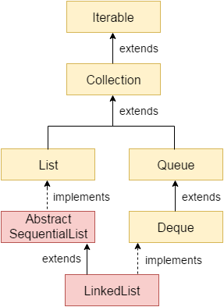
Java LinkedList class
Java LinkedList are:
Java LinkedList class can contain duplicate elements.
Java LinkedList class maintains insertion order.
Java LinkedList class is non synchronized.
In Java LinkedList class, manipulation is fast because no shifting needs to occur.
Java LinkedList class can be used as a list, stack or queue.

Slide 27
Java LinkedList Example
public static void main(String args[]){
LinkedList<String> al=new LinkedList<String>();
al.add("Ravi");
al.add("Vijay");
al.add("Ravi");
al.add("Ajay");
Iterator<String> itr=al.iterator();
while(itr.hasNext()){
System.out.println(itr.next());
}
}
Output :
Ravi
Vijay
Ravi
Ajay

Slide 28
LinkedList example – addfirst(), addlast(),removeFirst(),removelast() etc…
public static void main(String [] args) { LinkedList<String> ll=new LinkedList<String>();
ll.add("Ravi");
ll.add("Ravi");
ll.add("Vijay");
ll.add("Ajay");
System.out.println("Initial list of elements: "+ll);
//Removing first element from the list ll.removeFirst();
System.out.println("removeFirst() method: "+ll);
//Removing lastt element from the list ll.removeLast();
System.out.println("removeLast() method: "+ll);
ll.addFirst("Vijay");
ll.addLast("Ravi"); System.out.println("Updated list : "+ll);
//Removing first occurrence of element from the list
ll.removeFirstOccurrence("Vijay"); System.out.println("removeFirstOccurrence() method: "+ll);
//Removing last occurrence of element from the list
ll.removeLastOccurrence("Ravi"); System.out.println("removeLastOccurrence() method: "+ll);
//Removing of element on condition from list
ll.removeIf(str->str.contains("Vijay")); System.out.println("After invoking removeIf() method: "+ll);
//Removing all the elements available in the list
ll.clear();
System.out.println("clear() method: "+ll);
}

Slide 29
Output :
Initial list of elements: [Ravi, Ravi, Vijay, Ajay]
removeFirst() method: [Ravi, Vijay, Ajay]
removeLast() method: [Ravi, Vijay]
Updated list : [Vijay, Ravi, Vijay, Ravi]
removeFirstOccurrence() method: [Ravi, Vijay, Ravi]
removeLastOccurrence() method: [Ravi, Vijay]
After invoking removeIf() method: [Ravi]
clear() method: []

Slide 30
Queue Interface 1. A queue is an ordered of the homogeneous group of elements in which new elements are added at one end(rear) and elements are removed from the other end(front). 2. This interface represents a special type of list whose elements are removed only from the head. 3. LinkedList, Priority queue, ArrayQueue, Priority Blocking Queue, and Linked Blocking Queue are the concrete subclasses that implement the queue interface.

Slide 31
Methods in Queue:
add()- This method is used to add elements at the tail of queue. More specifically, at the last of linked-list if it is used, or according to the priority in case of priority queue implementation.
peek()- This method is used to view the head of queue without removing it. It returns Null if the queue is empty.
element()- This method is similar to peek(). It throws NoSuchElementException when the queue is empty.
remove()- This method removes and returns the head of the queue. It throws NoSuchElementException when the queue is empty.
poll()- This method removes and returns the head of the queue. It returns null if the queue is empty.
size()- This method return the no. of elements in the queue.

Slide 32
import java.util.LinkedList;
import java.util.Queue;
public class QueueExample
{
public static void main(String[] args)
{
Queue<Integer> q = new LinkedList<>();
// Adds elements {0, 1, 2, 3, 4} to queue
for (int i=0; i<5; i++)
q.add(i);
// Display contents of the queue.
System.out.println("Elements of queue-"+q);
// To remove the head of queue.
int removedele = q.remove();
System.out.println("removed element-" + removedele);
System.out.println(q);

Slide 33
// To view the head of queue
int head = q.peek();
System.out.println("head of queue-" + head);
int size = q.size();
System.out.println("Size of queue-" + size);
}
}
Output:
Elements of queue-[0, 1, 2, 3, 4]
removed element-0
[1, 2, 3, 4]
head of queue-1
Size of queue-4

Slide 34
Set Interface 1. This interface represents a collection of elements that contains unique elements. i.e, It is used to store the collection of unique elements. 2. Set interface does not maintain any order while storing elements and while retrieving, we may not get the same order as we put elements. All the elements in a set can be in any order. 3. Set does not allow any duplicate elements. 4. HashSet, LinkedHashSet, TreeSet classes implements the set interface and sorted interface extends a set interface. 5. It can be iterated by using Iterator but cannot be iterated using ListIterator.

Slide 35
Java HashSet class
Java HashSet class is used to create a collection that uses a hash table for storage.
It inherits the AbstractSet class and implements Set interface.
It has a following properties:
1. HashSet does not allow duplicate elements.
2. It doesn’t guarantee that the order will remain over time
3. It is backed by Hash table(actually a HashMap instance)
4. It permits the Null elements

Slide 36
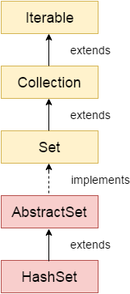
Difference between List and Set
A list can contain duplicate elements whereas Set contains unique elements only.
Hierarchy of HashSet class
The HashSet class extends AbstractSet class which implements Set interface. The Set interface inherits Collection and Iterable interfaces in hierarchical order.

Slide 37
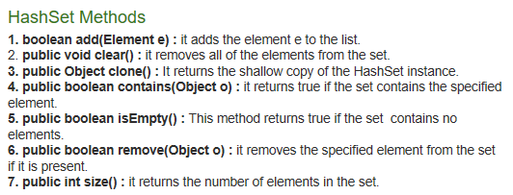

Slide 38
class Smart
{ public static void main(String[] args)
{ HashSet<Object> hashset = new HashSet<Object>();
Hashset.add(“Java”);
Hashset.add(“Collections”);
Hashset.add(“by Smart”);
Hashset.add(“Java”);
System.out.pritln(“The Set is”+ hashset);
}}

Slide 39
Example Java program to demonstrate internal working of HashSet
import java.util.HashSet;
class Test
{ public static void main(String args[])
{ HashSet hs = new HashSet();
boolean b1 = hs.add("Smart");
boolean b2 = hs.add("Smartwatch");
// adding duplicate element
boolean b3 = hs.add("Smart");
// printing b1, b2, b3
System.out.println("b1 = "+b1);
System.out.println("b2 = "+b2);

Slide 40
System.out.println("b3 = "+b3);
// printing all elements of hashset
System.out.println(hs);
}
}
Output:
b1 = true
b2 = true
b3 = false
[Smartwatch, Smart]

Slide 41
Basic operations on the Set - Union, Intersection and Difference.
public static void main(String args[]) {
Set<Integer> a = new HashSet<Integer>();
a.addAll(Arrays.asList(new Integer[] {1, 3, 2, 4, 8, 9, 0}));
Set<Integer> b = new HashSet<Integer>();
b.addAll(Arrays.asList(new Integer[] {1, 3, 7, 5, 4, 0, 7, 5}));
// To find union
Set<Integer> union = new HashSet<Integer>(a);
union.addAll(b);
System.out.print("Union of the two Set");
System.out.println(union);
// To find intersection
Set<Integer> intersection = new HashSet<Integer>(a);
intersection.retainAll(b);
System.out.print("Intersection of the two Set");
System.out.println(intersection);
// To find the symmetric difference
Set<Integer> difference = new HashSet<Integer>(a);
difference.removeAll(b);
System.out.print("Difference of the two Set");
System.out.println(difference);
}

Slide 42
Output
Union of the two Set[0, 1, 2, 3, 4, 5, 7, 8, 9]
Intersection of the two Set[0, 1, 3, 4]
Difference of the two Set[2, 8, 9]

Slide 43
LinkedHashSet
It implements a Set interface.
LinkedHashSet unlike HashSet maintains insertion order. That is elements are placed in the order they are inserted.
It should be preferred if you want a unique collection of objects in an insertion order.

Slide 44
Calculating Size and Searching for an Element in the LinkedHashSet
import java.util.*;
public class Example1 {
public static void main(String args[]) {
LinkedHashSet hs=new LinkedHashSet();
// Adding elements to the LinkedHashSet
hs.add(“S");
hs.add(“m");
hs.add(“a");
hs.add("r");
hs.add(“t");

Slide 45
// Getting the size of the LinkedHashSet
System.out.println("The size of the LinkedHashSet is "+ hs.size());
// Checking whether the LinkedHashSet contains an element or not
System.out.println("Is B Present in the LinkedHashSet?: "+ hs.contains("B"));
// Checking whether the LinkedHashSet contains an element or not
System.out.println("Is S Present in the LinkedHashSet?: "+ hs.contains("E"));
} }
Output:
The size of the LinkedHashSet is 7
Is B Present in the LinkedHashSet?: false
Is S Present in the LinkedHashSet?: true

Slide 46
Removing an Element from the LinkedHashSet
import java.util.*;
public class Example2 {
public static void main(String args[]) {
LinkedHashSet hs=new LinkedHashSet();
// Adding elements to the LinkedHashSet
hs.add(“S");
hs.add(“m");
hs.add(“a");
hs.add("r");
hs.add(“t");

Slide 47
System.out.println("Original LinkedHashSet: " + hs);
// Removing element e from the LinkedHashSet
System.out.println("Removal Status: "+hs.remove(“a"));
// Displaying the updated LinkedHashSet
System.out.println("Updated LinkedHashSet: "+ hs); } }
Output:
Original LinkedHashSet: [S, m, a, r, t]
Removal Status: true
Updated LinkedHashSet: [S, m, r, t]

Slide 48
SortedSet Interface 1. This interface extends a set whose iterator transverse its elements according to their natural ordering. 2. TreeSet implements the sorted interface.

Slide 49
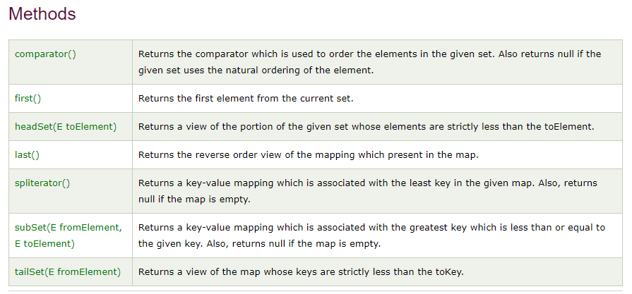
Sorted Set Methods

Slide 50
TreeSet Class
TreeSet Class is a NavigableSet implementation based on TreeMap.
Here, the elements are ordered using comparators.

Slide 51
import java.util.*;
public class SortedSetMethodsDemo {
public static void main(String args[]){
TreeSet <String> treeSetObject2 = new TreeSet<String>();
treeSetObject2.add("B");
treeSetObject2.add("C");
treeSetObject2.add("A");
treeSetObject2.add(“D");
System.out.println("Values in TreeSet object 2: " +treeSetObject2);
System.out.println("The first element is given as: " + treeSetObject2.first());
System.out.println("The last element is given as: " + treeSetObject2.last());

Slide 52
//Returns a view of the portion of the given set whose elements are strictly less than the toElement.
System.out.println("The respective element is given as: " + treeSetObject2.headSet(“B"));
//Returns a view of the map whose keys are strictly less than the toKey. System.out.println("The respective element is given as: " +treeSetObject2.tailSet(“D"));
}

Slide 53
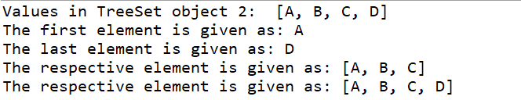
Output:

